Slide 1
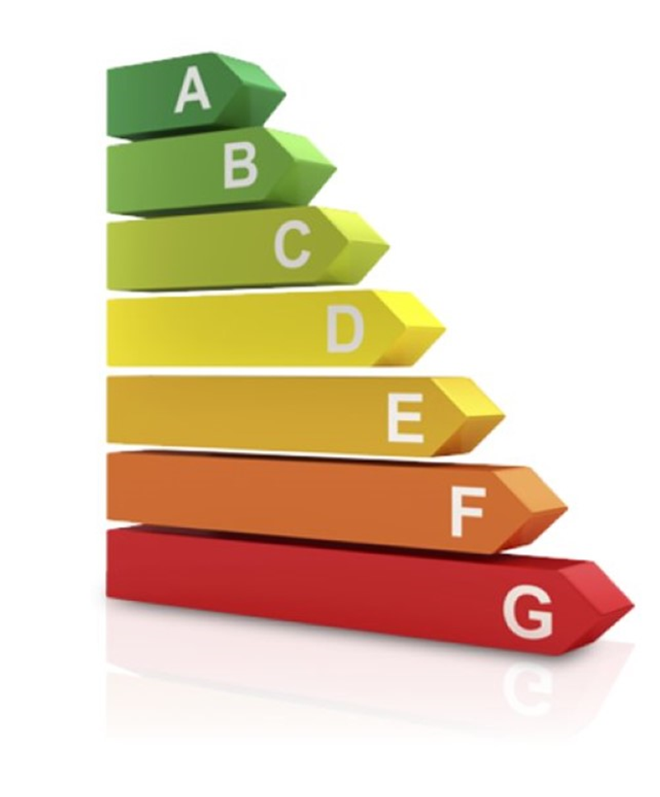
Energy Labels for Digital Services

Slide 2
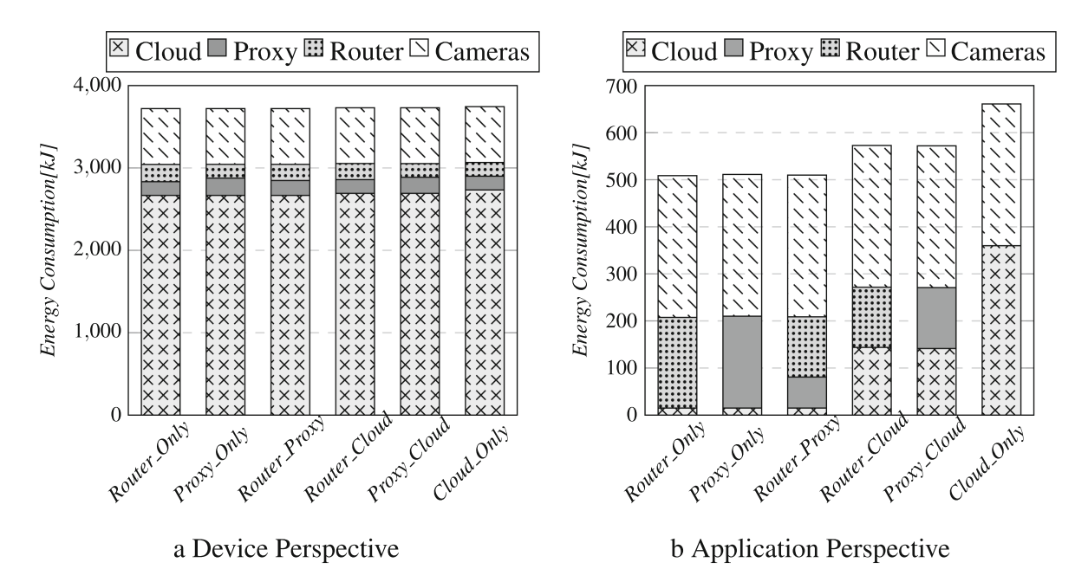
Introduction
RQ1: What are available frameworks for modeling computing continuum and energy consumption of applications?
We explore literature and chose iFogSim.
We conduct experiments with iFogSim to Analyze the energy consumption of applications.

Slide 3
Research Questions
RQ2: Modeling energy consumption of networking
RQ3: Study and analyze the effect of multi application
RQ2
…
RQ3
…

Slide 4
Network Energy Modeling and Multi Application Study

Slide 5
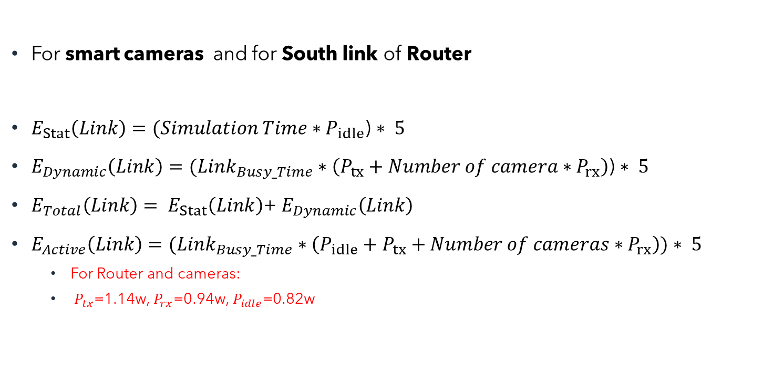
Wi-fi Network Energy
cloud
For smart cameras and for South link of Router
$E_{Stat}\left(Link\right)=(Simulation Time∗P_{idle}$) $∗ 5$
$E_{Dynamic}\left(Link\right)=(Link_{Busy_Time}∗\left(P_{tx}+Number of camera∗P_{rx}\right)$) $∗ 5$
$E_{Total}\left(Link\right)= E_{Stat}\left(Link\right)$+ $E_{Dynamic}\left(Link\right)$
$E_{Active}\left(Link\right)=(Link_{Busy_Time}∗\left(P_{idle}+P_{tx}+Number of cameras∗P_{rx}\right))$ $∗ 5$
For Router and cameras:
$P_{tx}$=1.14w, $P_{rx}$=0.94w, $P_{idle}$=0.82w
Proxy
server
Wi-Fi network
router
Smart camera
Smart camera
Smart camera
Smart camera

Slide 6
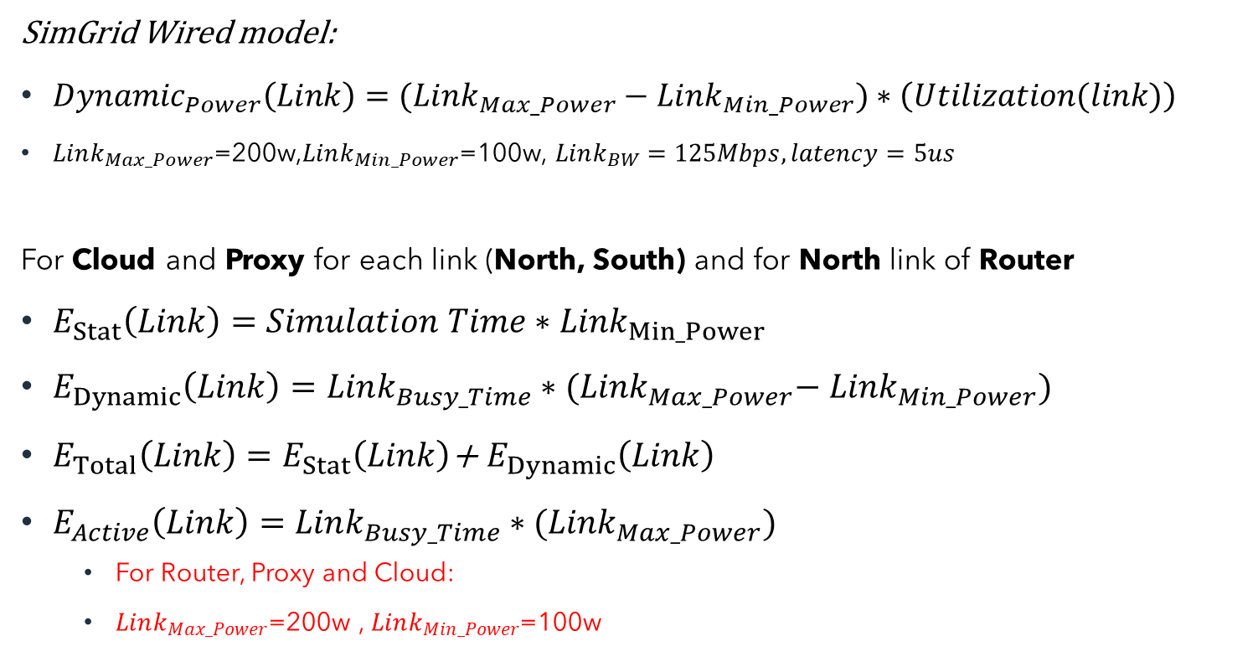
Wired Model^{[2]}
SimGrid Wired model:
${Dynamic}_{Power}\left(Link\right)=(Link_{Max_Power}−Link_{Min_Power})∗\left(Utilization(link)\right)$
$Link_{Max_Power}$=200w,$Link_{Min_Power}$=100w, $Link_{BW}=125Mbps, latency=5us$
For Cloud and Proxy for each link (North, South) and for North link of Router
$E_{Stat}\left(Link\right)=Simulation Time∗{Link}_{Min_Power}$
$E_{Dynamic}\left(Link\right)=Link_{Busy_Time}∗{(Link}_{Max_Power}−$ ${Link}_{Min_Power})$
$E_{Total}\left(Link\right)=E_{Stat}\left(Link\right)$+ $E_{Dynamic}\left(Link\right)$
$E_{Active}\left(Link\right)=Link_{Busy_Time}∗{(Link}_{Max_Power})$
For Router, Proxy and Cloud:
$Link_{Max_Power}$=200w , $Link_{Min_Power}$=100w
cloud
Wired network
Proxy
server
Wired network
router
Smart camera
Smart camera
Smart camera
Smart camera
^{[2].} Casanova, Henri. "Simgrid: A toolkit for the simulation of application scheduling." Proceedings First IEEE/ACM International Symposium on Cluster Computing and the Grid. IEEE, 2001.

Slide 7
WiFi-Wired Model Energy Results

Slide 8
Networking model calibration
Calibration problem
Considering literatures to calibrate model
We decided to consider other available networking energy models

Slide 9
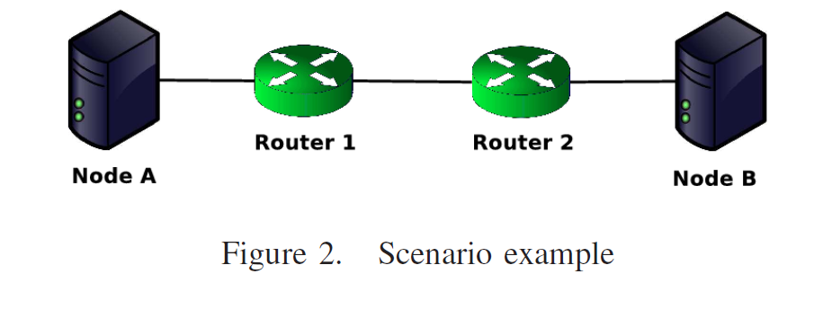
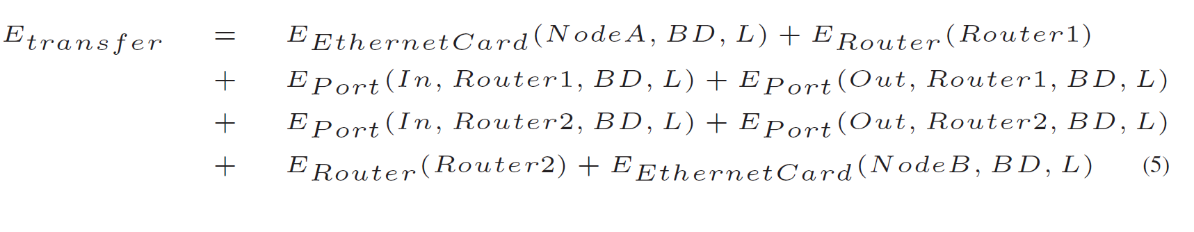
First Model: ECOFEN Energy Model
We don’t have information about the hops between two nodes!
First assumption: Only considering NICs of fog nodes and use the power parameters

Slide 10
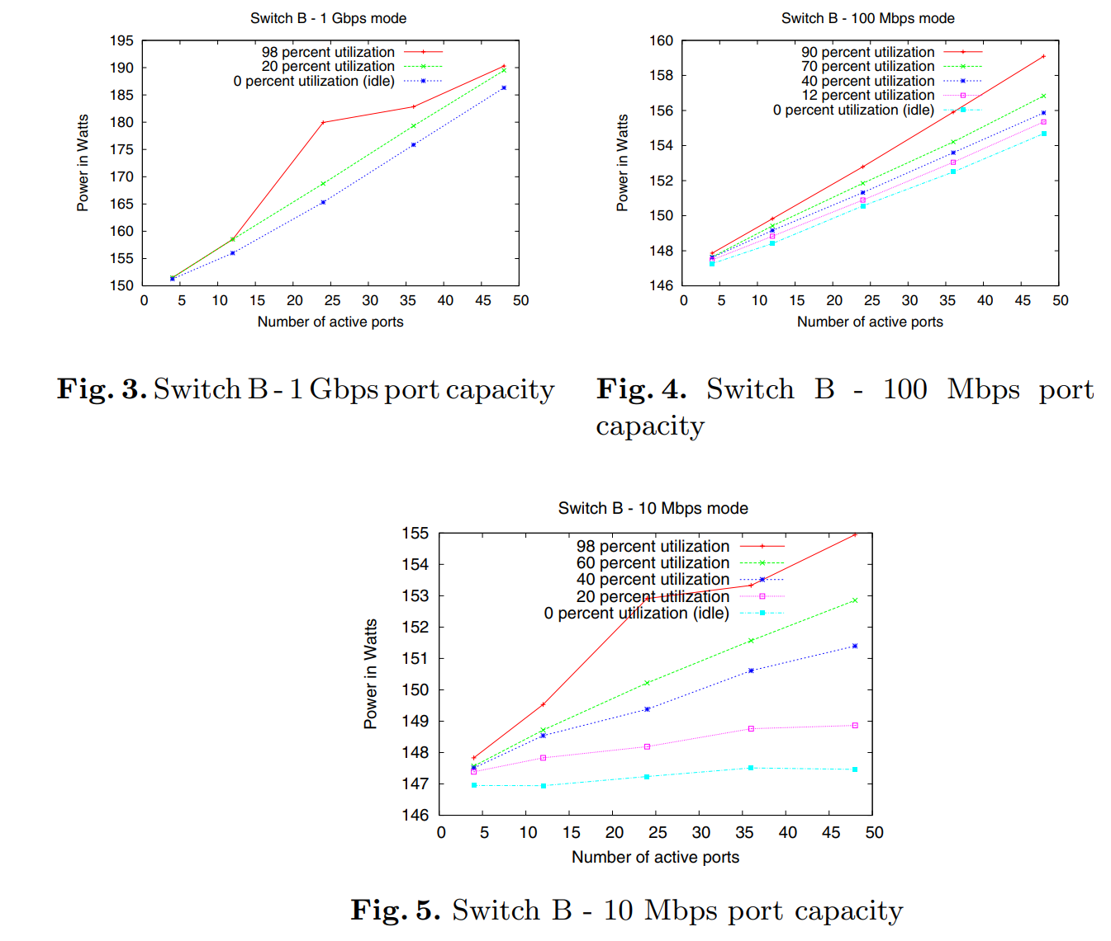
Effect of Port Capacity on Power Consumption
They observed that the effect of port capacity (BW) is not substantial
Second assumption: Consider Power numbers from their paper

Slide 11
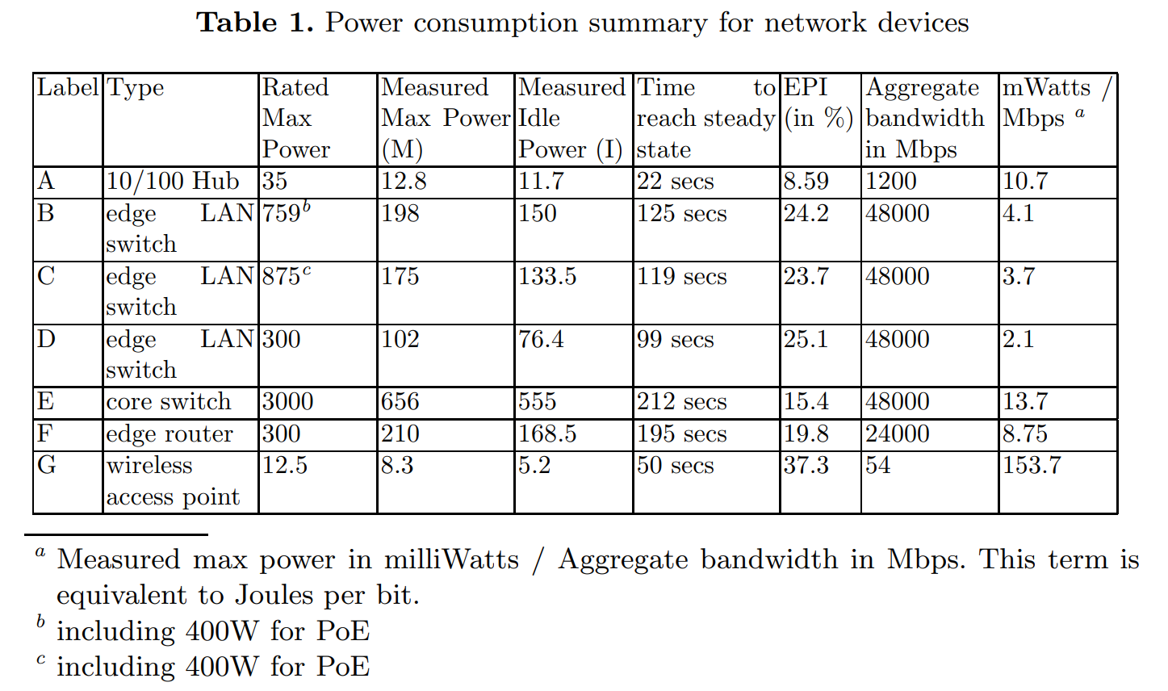
A Power Benchmarking Framework for Network Devices
Cloud
Default BW=10000
Latency=100
Modified BW=100000
Proxy server
Latency=2
Default BW=10000
Router
Modified BW=100000
Latency=2
Default BW=10000
Camera
Mahadevan, Priya, et al. "A power benchmarking framework for network devices." NETWORKING 2009: 8th International IFIP-TC 6 Networking Conference,, Aachen Germany, May 11-15, 2009. Proceedings 8. Springer Berlin Heidelberg, 2009.

Slide 12
Second Model: Flow-Based Networking Energy model
Two type of devices: 1.Shared and 2.End user equipment(CPE)
For shared equipment: Flow-based model
For equipment in end user premises (which are not shared): Time-based model
Jalali, Fatemeh, et al. "Fog computing may help to save energy in cloud computing." IEEE Journal on Selected Areas in Communications 34.5 (2016): 1728-1739.

Slide 13
Flow-based model for Shared equipment
Applications pay for active energy based on size of transferred data
Applications pay for idle energy during their active time with their BWs ratio
$$Active energy part=DataSize∗Energy per bit=BW∗t_{interval}∗\frac{{Power}_{max}−{Power}_{idle}}{Aggregate BW}$$
$$Idle energy part=DataSize∗\frac{{Power}_{idle}}{Active BW}=BW∗t_{interval}∗\frac{{Power}_{idle}}{Active BW}$$
$Aggregate BW=Uplink BW+$ $Downlink BW$
$Active BW=Uplink BW Or$ $Downlink BW$

Slide 14
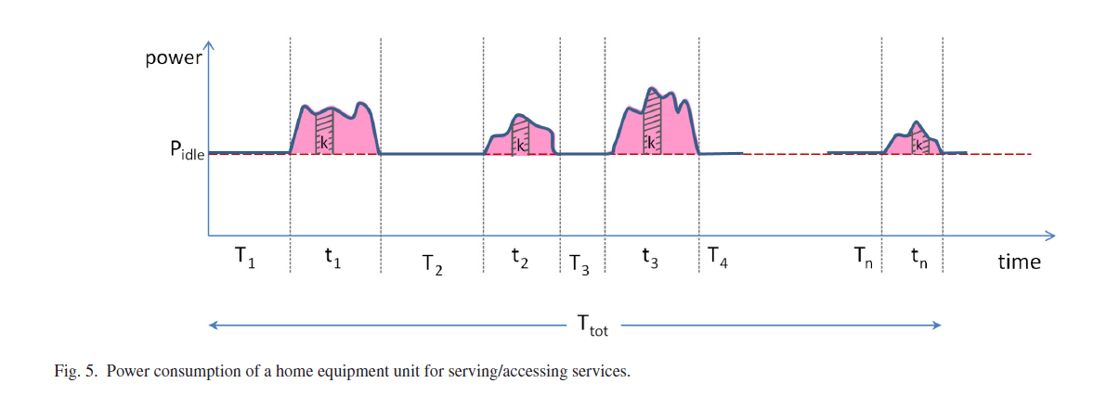
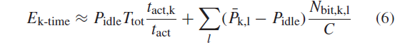
Time-based model Problem
Problem: The model only works correctly for time shared scenarios and not for space shared (e.g. dedicated BW of links)

Slide 15
Time-based model for user equipment
Applications pay for active energy during their active time with their BWs ratio
And pay for the Total Idle power of device with their BWs ratio
$$Active energy part=\sum_{Intervals}{\left({Power}_{max}−{Power}_{idle}\right)∗t_{interval}}∗\frac{BW}{Aggregate BW}$$
$$Idle energy part={Power}_{idle}∗\frac{Total simulation time}{Total NIC active time}∗\sum_{Intervals}{\frac{t_{interval}∗BW}{Active BW}}$$

Slide 16
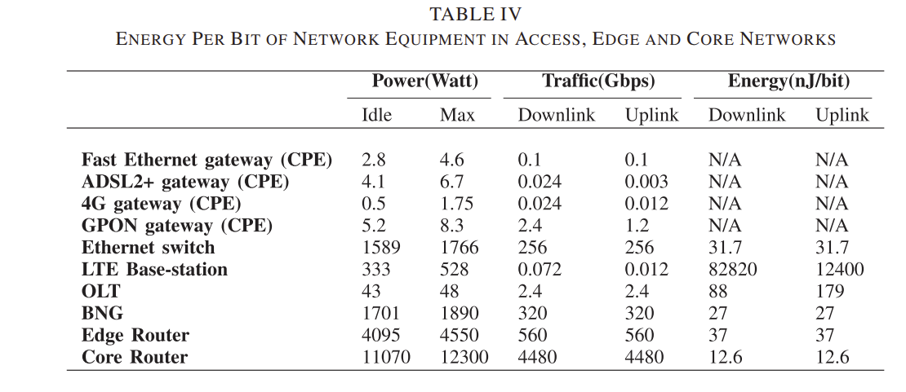
Flow-Based Energy model
cloud
$Application Networking Energy=E_{Cloud}$+$E_{Proxy}$+$E_{Router}$+ $E_{Camera}$
Shared devices(Flow-based model)
Proxy
server
router
Smart camera
Smart camera
Smart camera
Smart camera
End user devices (Time based model)

Slide 17
Networking models result
Different power parameters lead to different results
We consider flow-base networking energy model in our study

Slide 18
Simulator improvements
For Networking energy consumption:
Flow-base model for networking energy of NICs
Implement flow-based model to have energy result per Tuple(task)
For Computation energy consumption:
Improved iFogSim to report energy consumption per VMs of devices so we can track the energy of application modules
RQ2
RQ3
…

Slide 19
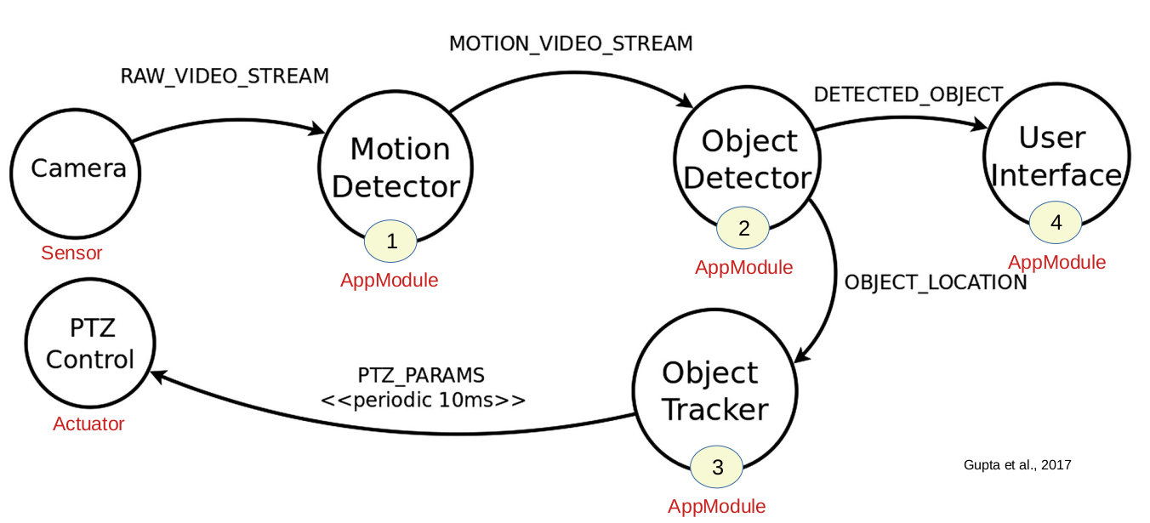
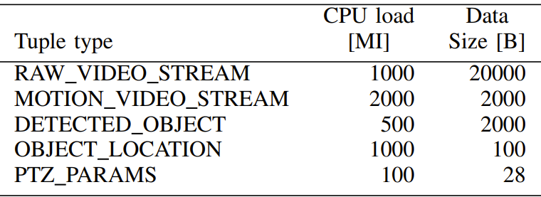
Surveillance Application

Slide 20
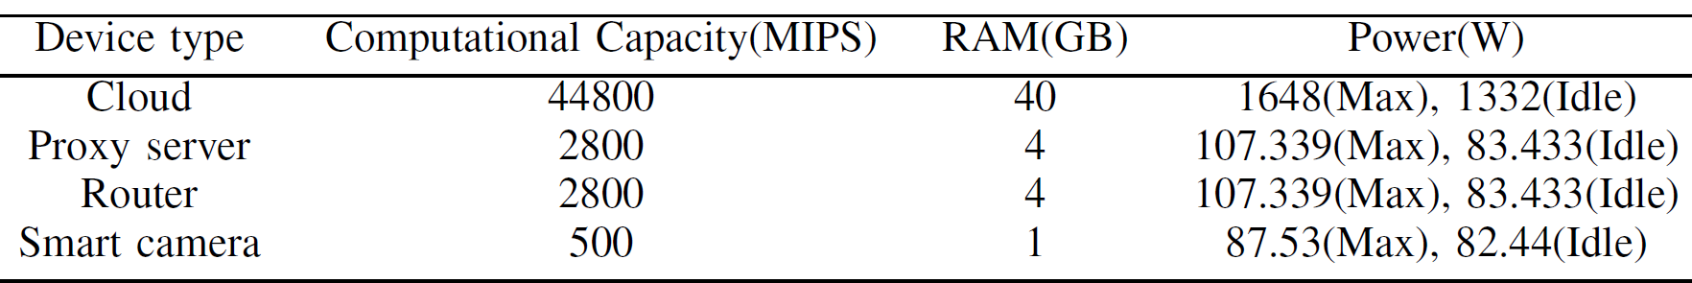
Topology
cloud
Proxy
server
router
Smart camera
Smart camera
Smart camera
Smart camera

Slide 21
Applications Mapping Scenarios
We consider Two instance of surveillance app
App_0:
Submission delay = 0
Sensors emitting delay =55
App_1:
Submission delay = 80
Sensors emitting delay =55
Total Simulation Time = 2000
App_0 energy tracking starts at time 55
App_1 energy tracking starts at time 80+55
Scenario | Application | Target device
Router_Only | App_0 App_1 | Router Router
Router_Proxy | App_0 App_1 | Router Proxy
Router_Cloud | App_0 App_1 | Router Cloud
Proxy_Only | App_0 App_1 | Proxy Proxy
Proxy_Cloud | App_0 App_1 | Proxy Cloud

Slide 22
Multi Applications networking energy results
By offloading tasks to upper-level devices the networking energy increases
The difference between energy of two apps in same device is because of starting point of App_0

Slide 23
Multi Applications Computation energy results
The difference between energy of two apps in same device is because of starting point of App_0
By running second app on cloud the energy consumption of App_1 is higher than App_0

Slide 24
Multi Applications Delay results
By placing both apps on same devices (oversubscription) the QoS drops due to queueing

Slide 25
Multi Applications Total Energy Results

Slide 26
Discussion
We designed experiments to study the effect of multi application
We consider both computation and networking energy
There are other possible mapping scenarios that we can consider
Consider placement of application modules
Calibration
Potential places to publish
RQ2
RQ3
…

Slide 27

Energy Calculation
State of device do not change between events
Device(Cloud)
Host
event₁
event₂
event₃
event₄
event₅
VM1
VM2
Task1
Task₁
Task₂
Idle
Task₃
…...
Δt₁
P₁
Δt₂
P₂
Δt₃
P₃
Δt₄
P₄
Time
E₁
E₂
E₃
E₄
E_{Task1} E₂ / 2 | E_{Task2} E₂ / 2 | E_{Task3} 0
Device Energy = E₁+E₂+E₃+ E₄...
Task₁ Energy = E₁+E₂/2
Task₂ Energy = E₂/2
Application Energy = E₁+E₂+E₄+ ...
Task₃ Energy = E₄

Slide 28
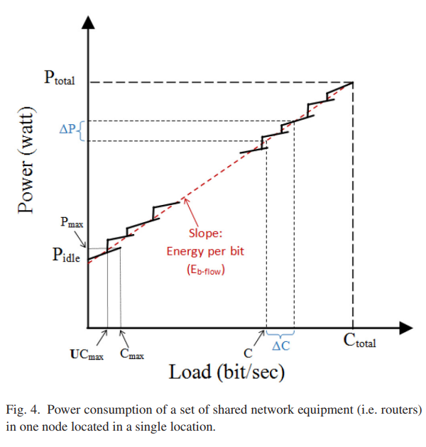
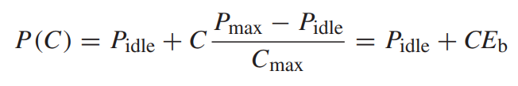
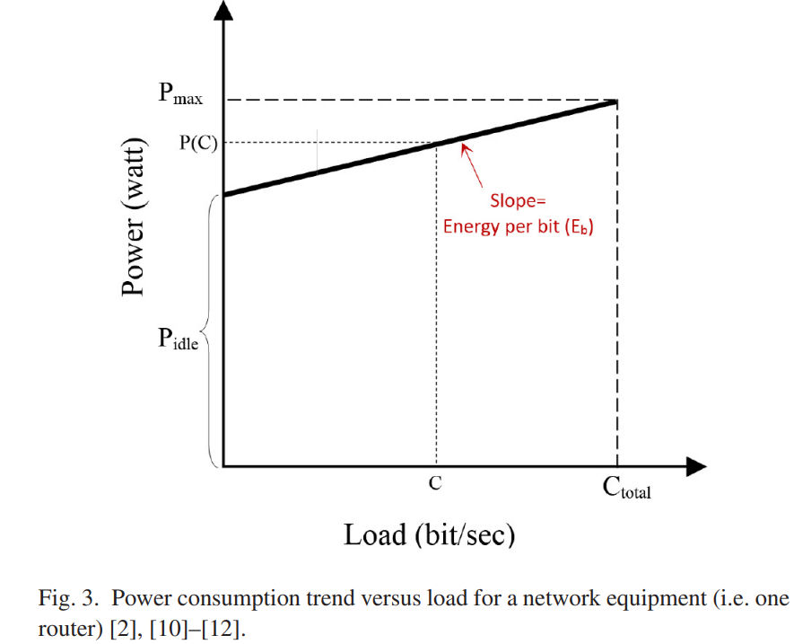
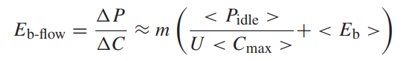
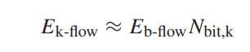
Flow-based model for Shared equipment

Slide 29
Time-based model for End user equipment

Slide 30
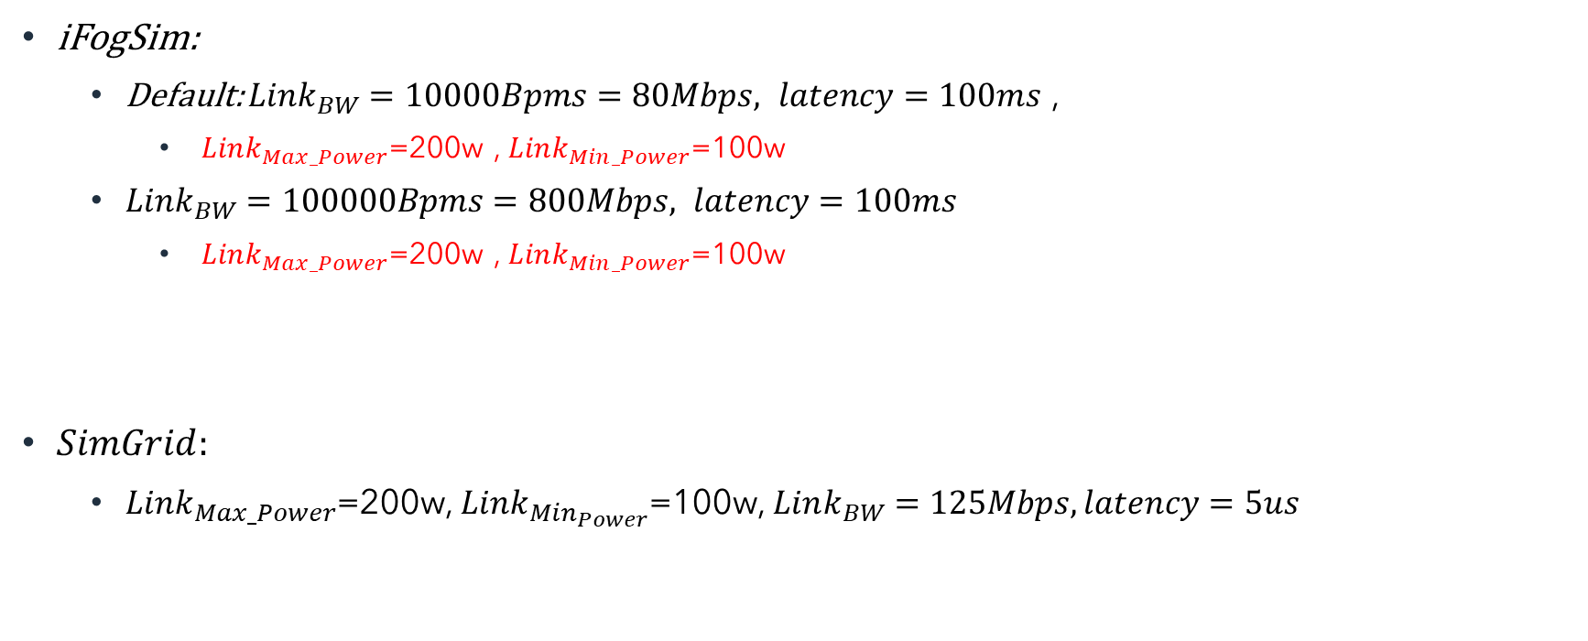
Links power
iFogSim:
Default: $Link_{BW}=10000Bpms=80Mbps, latency=100ms$ ,
$Link_{Max_Power}$=200w , $Link_{Min_Power}$=100w
$Link_{BW}=100000Bpms=800Mbps, latency=100ms$
$Link_{Max_Power}$=200w , $Link_{Min_Power}$=100w
$SimGrid:$
$Link_{Max_Power}$=200w, $Link_{Min_{Power}}$=100w, $Link_{BW}=125Mbps, latency=5us$

Slide 31
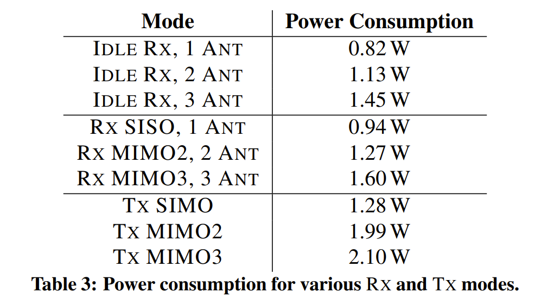
Power values for different states of laptops and desktop computers ^{[2]}
Network adapter is Intel 5300 (Which is common for laptops and desktop computers, and it is based on IEEE 802.11n wireless networking standard)
^{[2].} Halperin, Daniel, et al. "Demystifying 802.11 n power consumption." Proceedings of the 2010 international conference on Power aware computing and systems. USENIX Association, 2010.

Slide 32
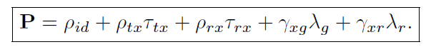
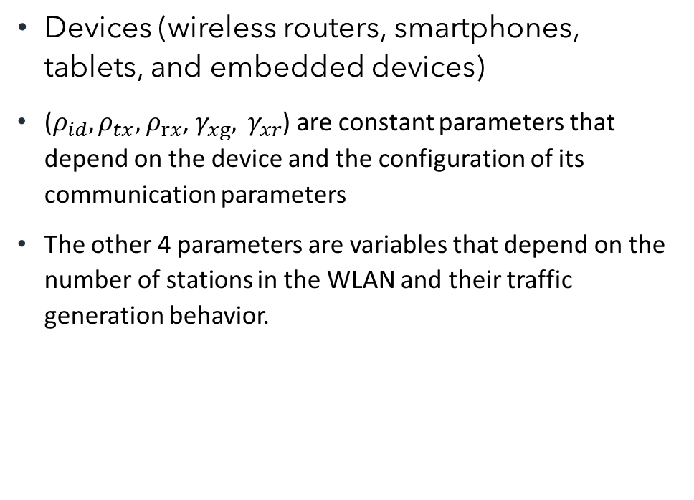
Per frame energy model
Devices (wireless routers, smartphones, tablets, and embedded devices)
($ρ_{id}, ρ_{tx},$ $ρ_{rx}$, $γ_{xg}, γ_{xr}$) are constant parameters that depend on the device and the configuration of its communication parameters
The other 4 parameters are variables that depend on the number of stations in the WLAN and their traffic generation behavior.

Slide 33
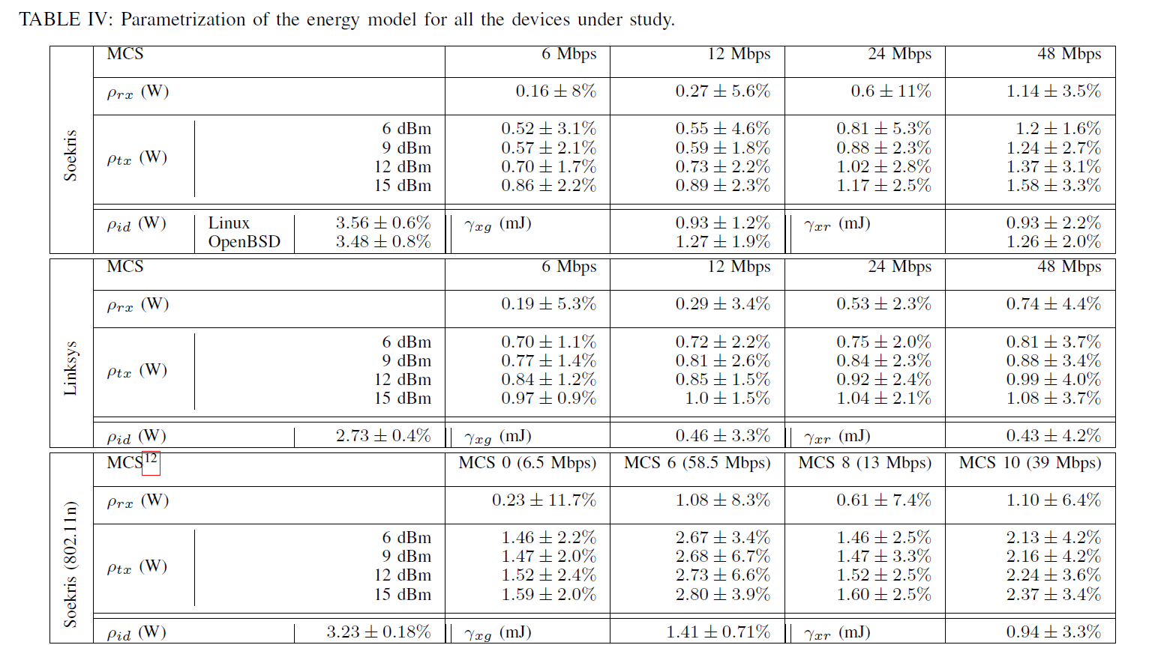
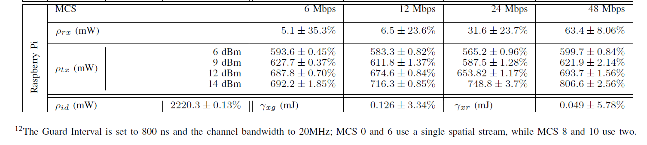
Power values for different states of Wireless Routers and AP

Slide 34
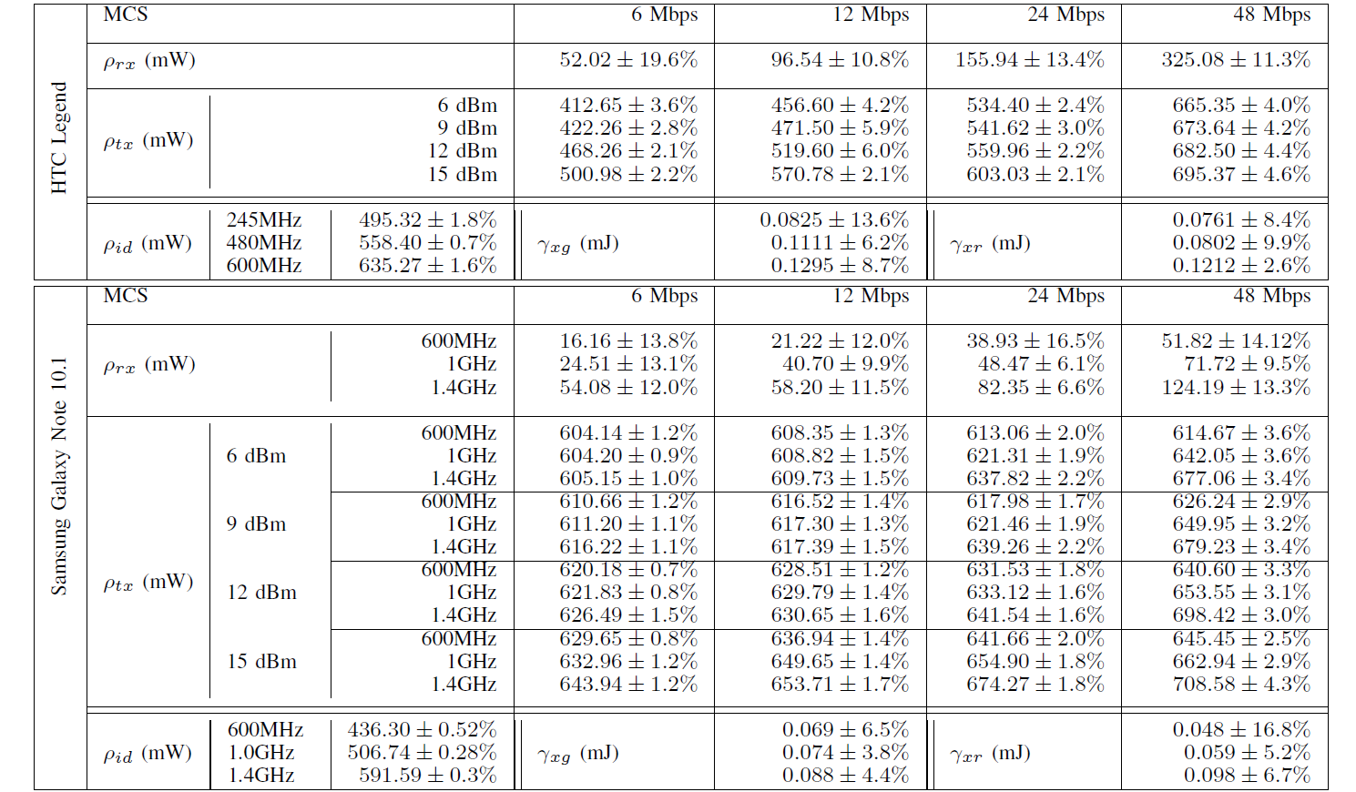
Power values for different states of Smartphone and Tablet

Slide 35
Power values for different states of an Embedded device

